Slide 1
EAS 3801 Space Mechanics
Dr. Ahmad Salahuddin Mohd Harithuddin

Slide 2
Space Mechanics
Celestial mechanics examines the dynamic motions of celestial objects
Orbital dynamics studies the motion of all orbiting bodies
Attitude dynamics deals with the orientation of an object
Astrodynamics is the study of the motion of man-made objects in space, subject to both natural and artificially induced forces.

Slide 3
Textbooks
Fundamentals of Astrodynamics, Bate, Mueller, and White 1971
An Introduction to the Mathematics and Methods of Astrodynamics, Battin 1999
Introduction to Space Dynamics, Thomson, 1961
Celestial Mechanics, Danby, 1962
Methods of Orbital Determination, Escobal, 1965
Modern Spacecraft Dynamics and Control, Kaplan, 1976
Orbital Mechanics, Chobotov, 1996
Spaceflight Dynamics, Wiesel, 1996
Fundamentals of Astrodynamics and Applications, Vallado, 1997
Orbital Mechanics for Engineering Students, Curtis, 2014

Slide 4
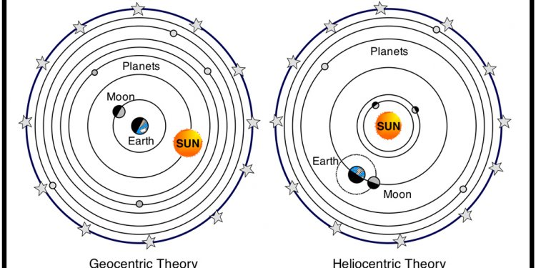
Ancient Thinking on Astronomy

Slide 5
Problem with Geocentric

Slide 6
Heliocentric

Slide 7
Heliocentric vs Geocentric Model

Slide 8
Copernicus’ model
The planetary orbit is a circle
The Sun at the center of the orbit
The speed of the planet in the orbit is constant

Slide 9
Kepler’s Law
The planetary orbit is an ellipse, with the Sun at one of its foci
The line joining the planet to the Sun sweeps out equal areas in equal times
The square of the period of a planet is proportional to the cube of its semi-major axis (mean distance) from the Sun

Slide 10

Elliptical Orbit (Kepler 1)
a
a
b
r
$$θ$$
periapsis
c
apoapsis
r_{a}
r_{p}

Slide 11


Satellite on an elliptical orbit around Earth
r
$$θ$$
perigee
apogee

Slide 12

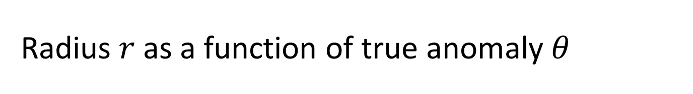
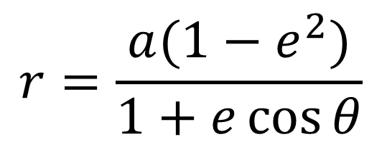
Radius $r$ as a function of true anomaly $θ$
r
$$θ$$
$$r=\frac{a(1−e^{2})}{1+e\cos{θ}}$$

Slide 13
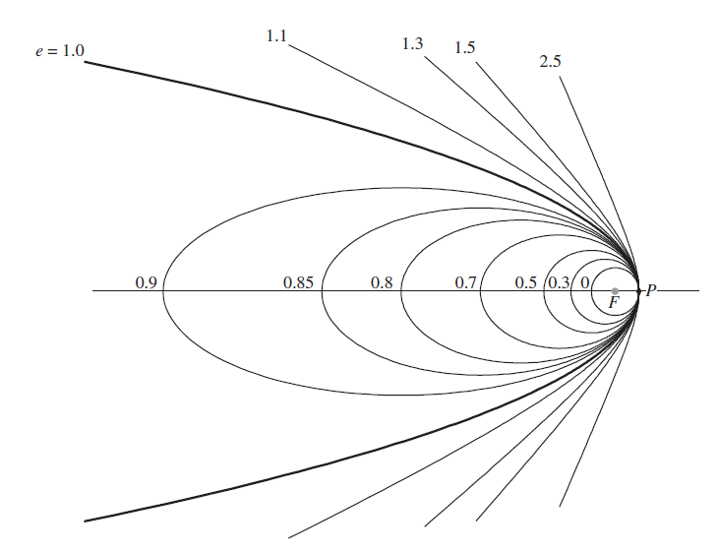
Orbits with different eccentricity e with a common focus at F and periapsis at P

Slide 14
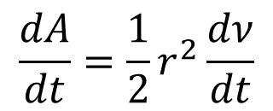
Kepler’s Law of Equal Areas (Kepler 2)
$$\frac{dA}{dt}=\frac{1}{2}r^{2}\frac{dν}{dt}$$
A line joining a planet and the Sun sweeps out equal areas in equal intervals of time.
The orbital radius and angular velocity of the planet in the elliptical orbit will vary. This is shown in the animation: the planet travels faster when closer to the focus, then slower when farther from the focus.

Slide 15
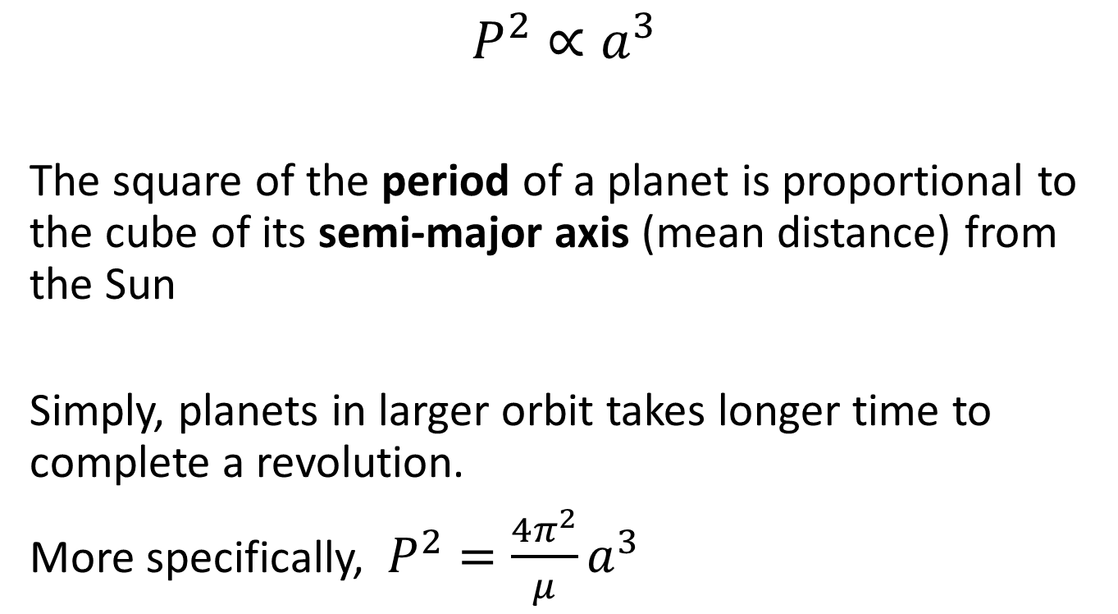
Kepler’s Law of Periods (Kepler 3)
$$P^{2}∝a^{3}$$
The square of the period of a planet is proportional to the cube of its semi-major axis (mean distance) from the Sun
Simply, planets in larger orbit takes longer time to complete a revolution.
More specifically, $P^{2}=\frac{4π^{2}}{μ}a^{3}$

Slide 16
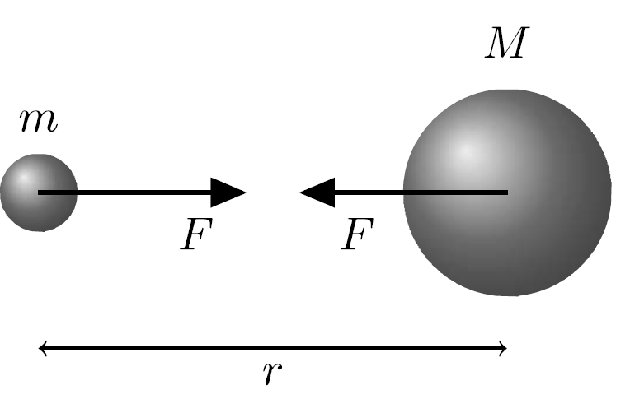
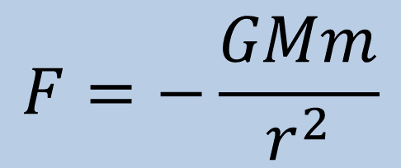
Newton’s Law of Universal Gravitation
$$F=−\frac{GMm}{r^{2}}$$

Slide 17
